Slide 1
Broken
Access Control
ANTN teams.

Slide 2


Our team
Internal
External
Nguyễn Bùi Kim Ngân
Lưu Nguyễn Công Minh

Slide 3


Our team
Collaboration
Demo
Nguyễn Bình Thục Trâm
Võ Anh Kiệt

Slide 4
Table of contents
01.
02.
03.
Overview
Internal
External
04.
05.
Collaboration
Demo
Overview of the broken access control system
Broken access control from inside
Broken access control from outside
Broken access control from collaboration
Demo some kinds of broken access control

Slide 5
01.
Overview
Overview of the broken access control

Slide 6
Definition
Access control vulnerabilities occur when users are able to act outside of their intended permissions. This typically leads to unauthorized access, information disclosure, and modification or destruction of data.

Slide 7
02.
Internal
Broken access control from inside

Slide 8
Causes
Internal users can access, modify, delete or perform actions outside an application or systems’ intended permissions. Since the design and management of access controls is a complex and dynamic problem, errors are potentially high.

Slide 9
Vertical Privilege Escalation
Gain elevated access to resources that are normally protected, get more permissions, gain admin and root control and obtain access to sensitive systems.

Slide 10
Methods
Credential Exploitation | User/password
Exploit vulnerabilities | Design, implementation, or configuration
Malware | Deploy malware at admin or root level, and use it to gain access
Social Engineering

Slide 11
Horizontal Privilege Escalation
A user gains the access rights of another user who has the same access level

Slide 12
Methods
Credential Exploitation
Cross-site Scripting
Social Engineering
User/password

Slide 13
Bypass Firewall
Access to resources, applications,... or perform actions as they are blocked by firewall

Slide 14
Methods
Use VPN
SSH Tunneling
Web Proxy
Use Google translate as a Proxy Server

Slide 15
03.
External
Broken access control from outside

Slide 16
Definition
An external threat refers to the risk of somebody from the outside of a company who attempts to exploit system vulnerabilities through the use of malicious software, hacking, sabotage or social engineering.
These can be much harder to deal with than internal threats, as you cannot monitor people from the outside like you can employees, nor can you predict what they might do next.

Slide 17
Type of External Attacks
Password Bruteforce
Packet spoofing or IP spoofing
Sniffing
Malware
Packet spoofing or IP spoofing
Social engineering
1
4
2
5
3
6

Slide 18
Password Bruteforce
Simple brute force attack | Compare every possible combination and permutation of characters available until the match is found.
Rainbow table attack | The passwords in a computer system are not stored directly as plain texts but are hashed using encryption.

Slide 19
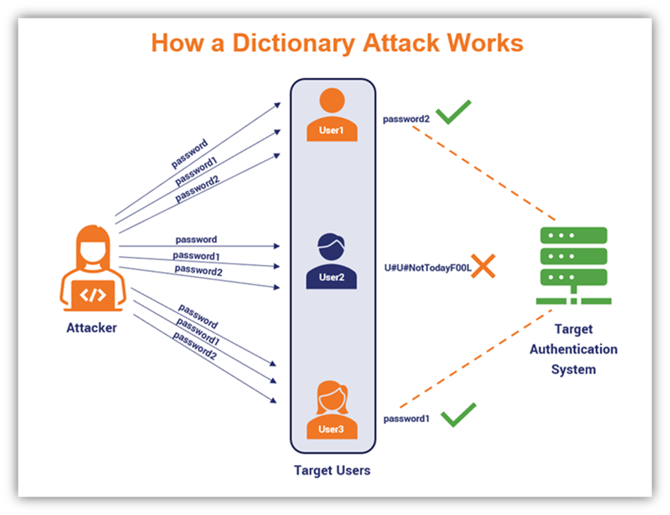
Dictionary attack
Surmises usernames or passwords utilizing a dictionary of potential strings or phrases.

Slide 20
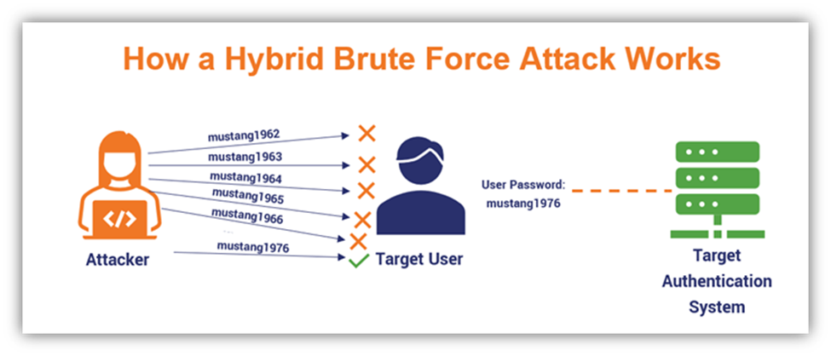
Hybrid attack
Use a dictionary attack with a check for extra characters attached to either end of the word.

Slide 21
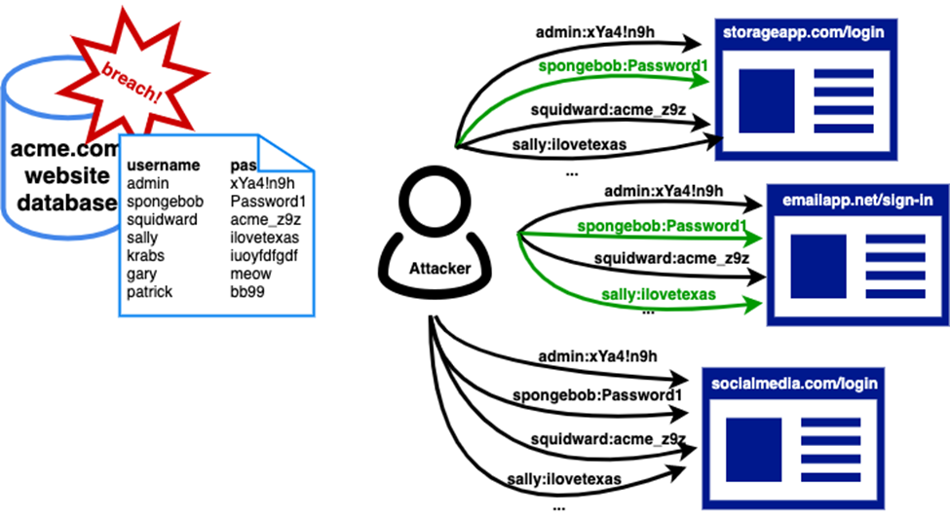
Credential stuffing
The automated injection of stolen username and password pairs (“credentials”) in to website login forms, in order to fraudulently gain access to user accounts.

Slide 22
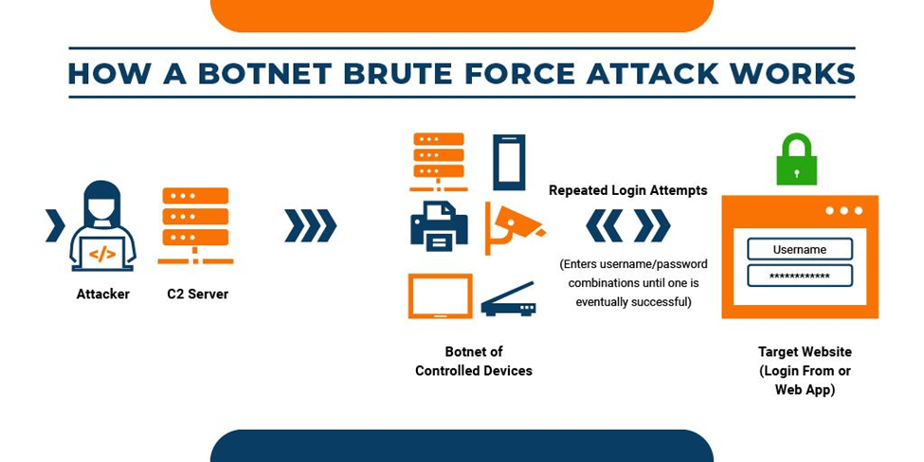
Botnet attack
Instead of using hacker’s own machine, now bring a bunch of computers that have been “infected” and controlled by the hacker to brute force the password.

Slide 23
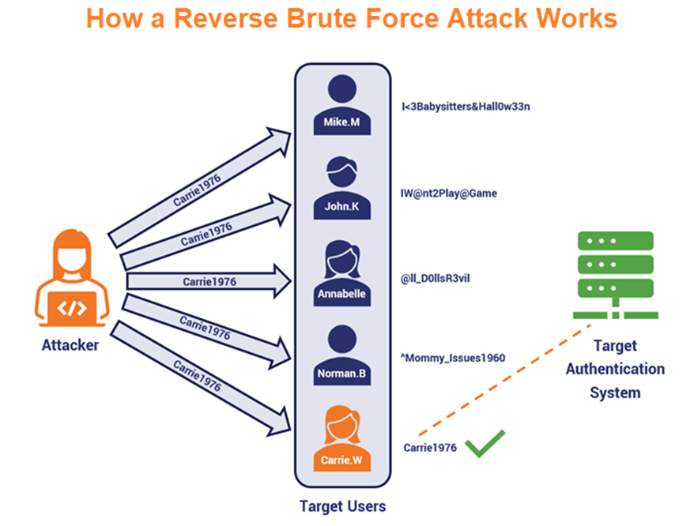
Reverse Brute Force Attack

Slide 24
Sniffing
Packet sniffing is a technique whereby packet data flowing across the network is detected and observed. Network administrators use packet sniffing tools to monitor and validate network traffic, while hackers may use similar tools for nefarious purposes.

Slide 25

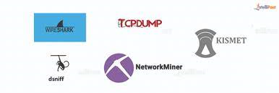
Sniffing tools

Slide 26
Packet spoofing or IP spoofing
The creation of Internet Protocol (IP) packets having a source IP address with the purpose of concealing the identity of the sender or impersonating another computing system.

Slide 27
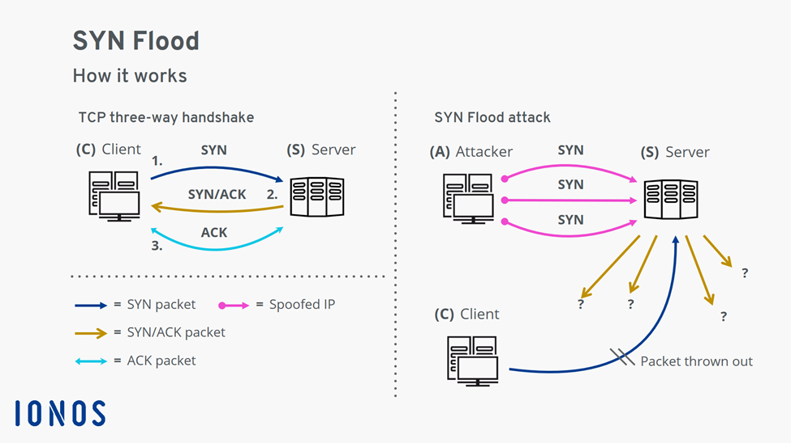
SYN Flood Attack

Slide 28
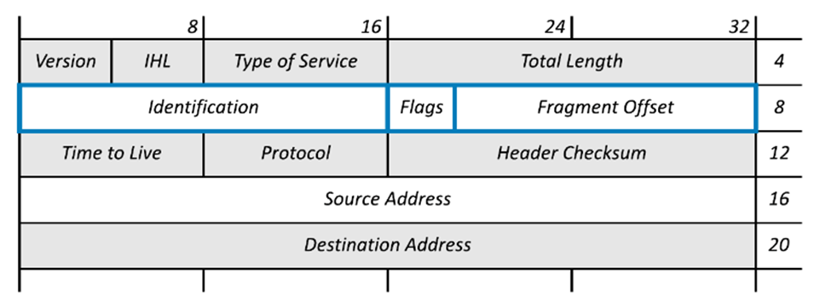
Teardrop attack
A type of denial-of-service (DoS) attack (an attack that attempts to make a computer resource unavailable by flooding a network or server with requests and data.)

Slide 29
Exploiting security weaknesses
Use vulnerability assessment tools to probe network systems, then exploiting identified vulnerabilities to gain access to or to break-in to the system.

Slide 30

Exploiting security weaknesses
- Nikto2 is an open-source vulnerability scanning software that focuses on web application security.

Slide 31

Exploiting security weaknesses
- OpenVAS is a powerful vulnerability scanning tool that supports large-scale scans which are suitable for organizations. Not only in the web application or web servers but also in databases, operating systems, networks, and virtual machines.

Slide 32
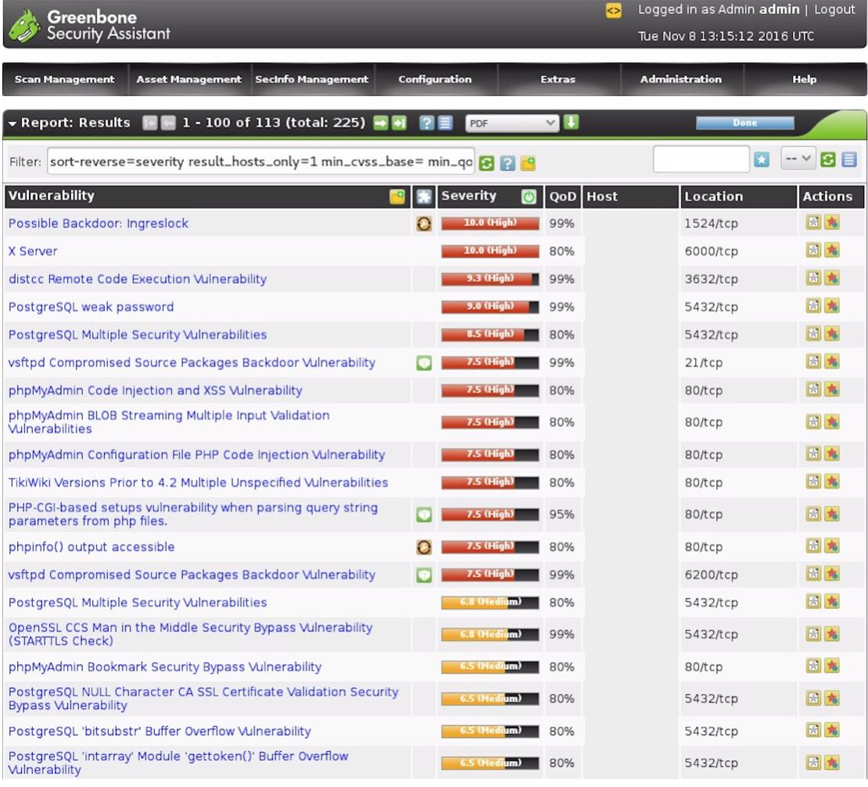

Slide 33
Malware
Malicious software (malware) is a catchall term for software created to cause damage in a computer or computer system. These are three of the most types of malware.

Slide 34
Spyware | A type of malware that gathers information, like login credentials and other sensitive customer data
Ransomware | A ransomware attack encrypts your files and storage devices, thus rendering them inaccessible until you’ve paid a set amount to the attackers
Viruses | Viruses are malicious code that replicate in order to spread to other computers, files, or systems, typically inserting their own executable code into a device’s software
Worms | Perform a similar function to viruses. However, worms can replicate themselves through a network to spread to other computers, rather than through infecting files that are spread
Trojans | Malicious code that hides within a seemingly legitimate program. Typically, users are misled and download the Trojan themselves by thinking it’s a program they would like to use.

Slide 35
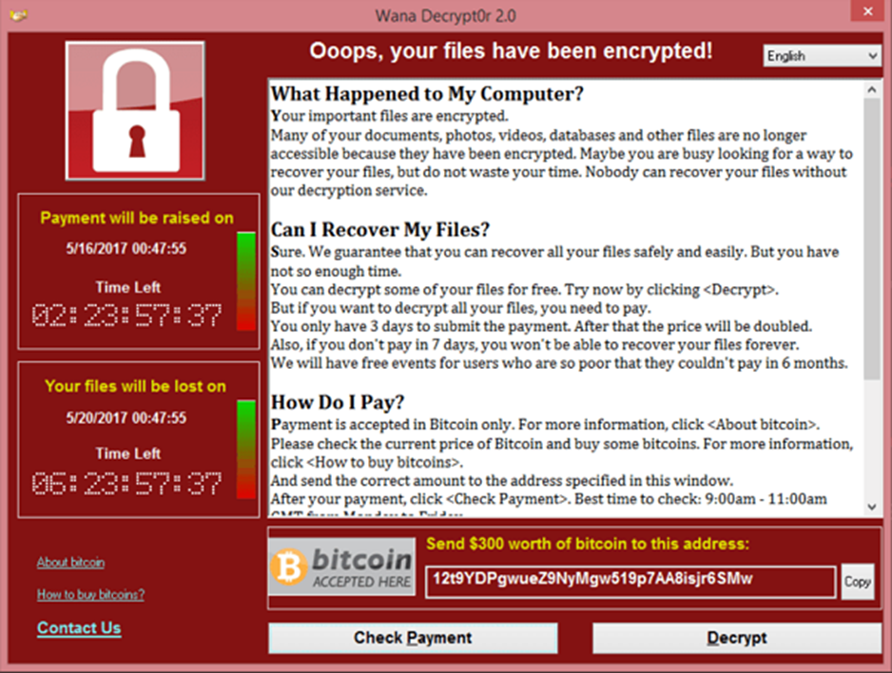
Ransomware

Slide 36
Social engineering
Intruders trick legitimate users into disclosing information they want. The information can be confidential or sensitive information. They prey on qualities of human nature such as a desire to be helpful, a tendency to trust people, or fear of getting in trouble.

Slide 37
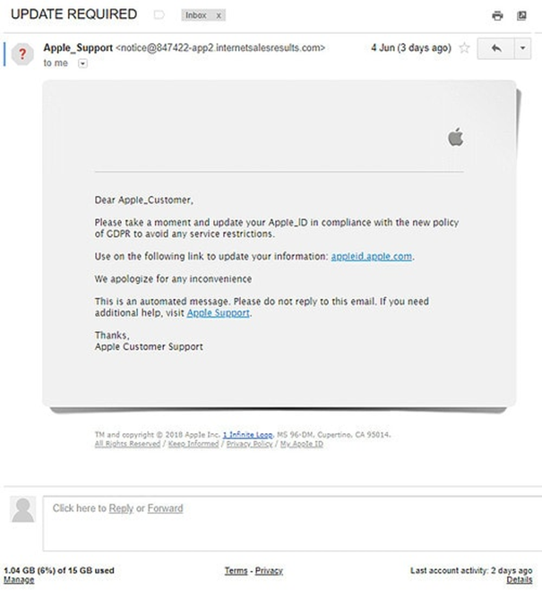
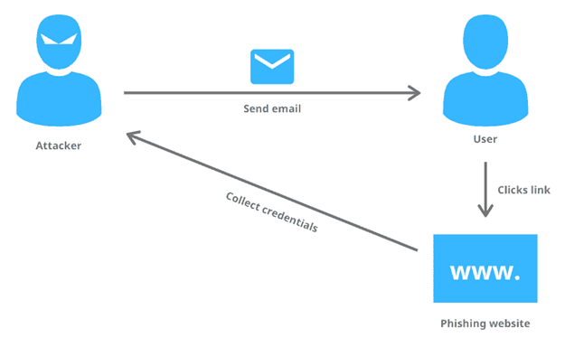
Phishing
2.

Slide 38
04.
Collaboration
Broken access control from collaboration

Slide 39
Causes
1.
2.
Collaborators can broke access control by the information and permission in the system they got when collab together
System owners' lack of vigilance when granting access for collaborations.

Slide 40
Consequence
Failures typically lead to unauthorized information disclosure, modification, or destruction of all data or performing a business function outside the collaborators’ limits

Slide 41
Common cases
01.
03.
02.
Collaboration knows source code of system.
Collaboration has specific permission in system.
Collaboration knows specific information of system.

Slide 42
Collaboration knows source code of system.
Outsource software, system, website,...
Public source code.
Selling or sharing similar technical products for collaborations.
…

Slide 43
Common Vulnerabilities
Buffer or Stack Overflow
Insecure Direct Object References
Null Dereference

Slide 44
Conclusion
Knowing the source code is the most vulnerable to collaborators breaking access control systems and can cause serious damage.

Slide 45
Collaboration knows specific information of system.
Accidentally sharing some secrets of system to collaborations.
Lack of information about system when collab together.
Non-compliance with Content Security Policy while collab.
…

Slide 46
Common Vulnerabilities
Password Attacks
Social Engineering Attacks

Slide 47
Conclusion
In this case, collaborators can get inside the system and get more information to prepare a more dangerous Privilege Escalation attack.

Slide 48
Collaboration has specific permission in system.
Lacking of vigilance when granting access for collaborations.

Slide 49
Common Vulnerabilities
Smart Card Attacks
Privilege Escalation

Slide 50
Conclusion
In this case, collaborators are already inside the system, so if they have permission high enough, it will be very dangerous.

Slide 51
05.
Demo

Slide 52
THANKS FOR WATCHING

